Slide 1

About Me

Slide 2
UK Hospital Data Analysis
A Comprehensive Exploration of Hospital Data Using Python, Excel, and Power BI

Slide 3
Introduction
This analysis explores hospital data, focusing on hospital types, location, public/private sectors, and organizational structure to inform healthcare understanding.

Slide 4

Table of contents
Data Cleaning & Preprocessing
Exploratory Data Analysis (EDA)
Advanced Data Analysis
Objective
Tools
Dashboard
Strategic Recommendations

Slide 5




Tools
Objectives
Explore the distribution of hospitals by type and subtype to understand the composition of healthcare facilities.
Visualize the geographical distribution of hospitals to identify regional patterns and potential disparities.
Determine the distribution of hospitals between the public (NHS Sector) and private (Independent Sector).
Analyze the influence of parent organizations on hospital distribution. .
Examine the density of hospitals across latitude and longitude coordinates.

Slide 6
Data Cleaning & Preprocessing
Handle Missing Values
Check for Missing Values
Check for Duplicates and Remove Them
Standardize Phone and Website Formats
Save the cleaned data

Slide 7
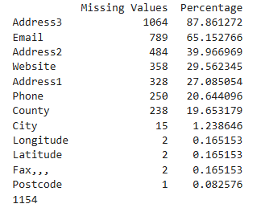
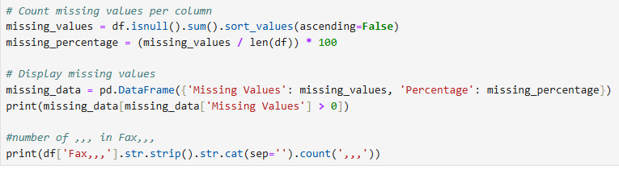
Check for Missing Values
Check for missing values in the dataset by using functions like isnull() in Pandas, which returns a boolean DataFrame indicating the presence of missing values. Summarize the total count of missing values for each column to identify which variables need attention for data cleaning.

Slide 8
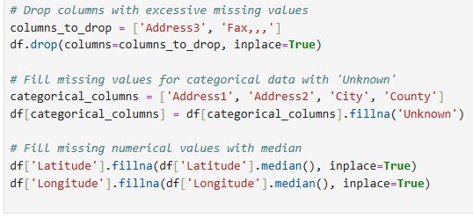
Handle Missing Values
Handle missing values by deciding on an appropriate strategy, such as imputing missing values with the mean, median, or mode, depending on the data type and distribution. Alternatively, you can drop rows or columns with excessive missing data using dropna() in Pandas to ensure the dataset remains robust for analysis.

Slide 9
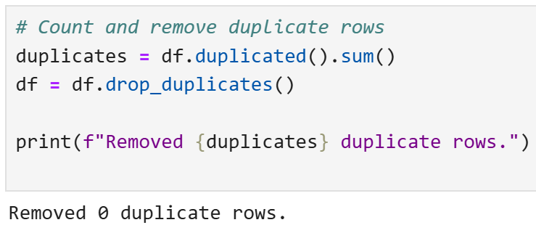
Check for Duplicates and Remove Them
Check for duplicates in the dataset using the duplicated() function in Pandas, which identifies any rows that are exact copies of others. To ensure data integrity, remove these duplicate entries by applying the drop_duplicates() function, keeping only unique records necessary for accurate analysis.

Slide 10
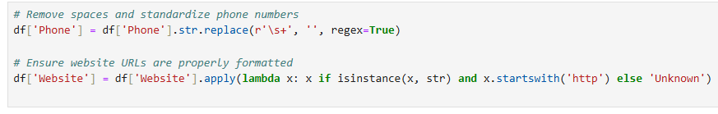
Standardize Phone and Website Formats
Standardize phone and website formats by applying string manipulation techniques to ensure uniformity in data representation.
Notes:
For phone numbers, convert them to a common format using regular expressions to remove special characters and enforce a consistent international dialing format. For websites, ensure that all URLs are corrected to include the proper scheme (http:// or https://) and are free of unnecessary parameters or trailing slashes.

Slide 11
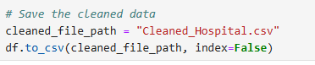
Save the cleaned data
Save the cleaned data by using the to_csv() function in Pandas, specifying the desired file path and name. Ensure to set parameters like index=False to avoid saving the DataFrame index as a separate column. This step allows for easy retrieval and use of the cleaned dataset for future analysis or reporting.

Slide 12
Exploratory Data Analysis (EDA)
Distribution of Hospital Types
Public vs Private Hospitals
Top 10 Cities with the Most Hospitals
Geographic Distribution of Hospitals

Slide 13
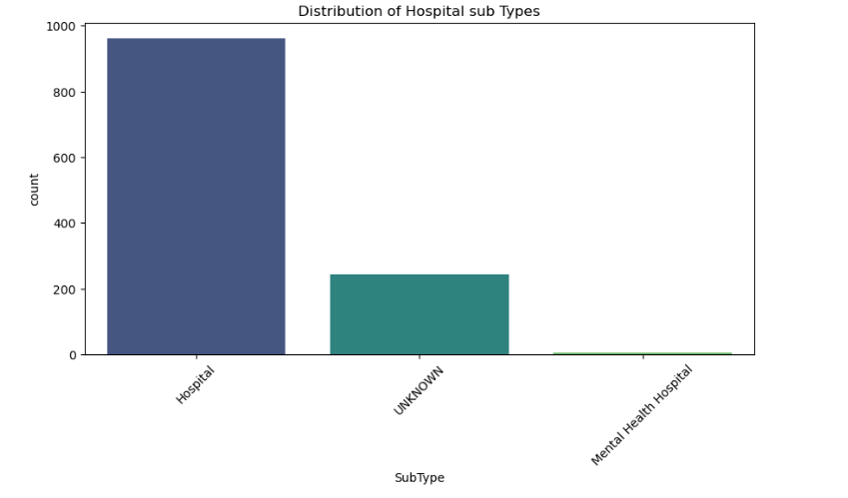
Distribution of Hospital Types
Analyse the distribution of hospital types by categorizing hospitals into various classifications such as public, private, non-profit, and for-profit.
The count plot shows that 'Hospital' is the predominant SubType, followed by 'UNKNOWN' and then 'Mental Health Hospital’.
This indicates that the dataset primarily focuses on general hospitals rather than other sub types.

Slide 14
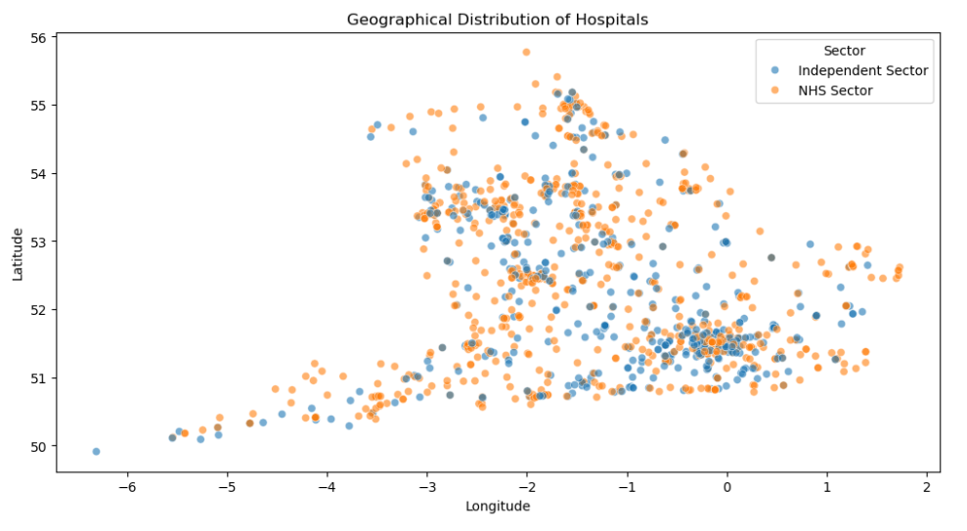
Geographic Distribution of Hospitals
Examine the geographic distribution of hospitals by mapping their locations across different regions. Visualising hospital locations in relation to population density, regional healthcare needs, and accessibility can highlight areas that may require additional medical facilities or resources.
The scatter plot reveals a concentration of hospitals in certain areas, particularly in the southern regions of the UK. Both NHS Sector and Independent Sector hospitals are distributed throughout the region, but there might be local clusters of one sector or the other. Further analysis could explore the reasons behind these clusters and their implications for healthcare access.

Slide 15
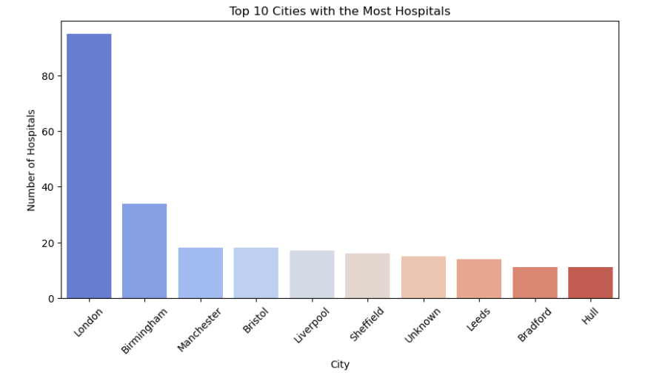
Top 10 Cities with the Most Hospitals
Identify the top 10 cities with the most hospitals by aggregating data based on the number of healthcare facilities within each city.
This analysis help inform healthcare policy decisions and resource allocation.

Slide 16
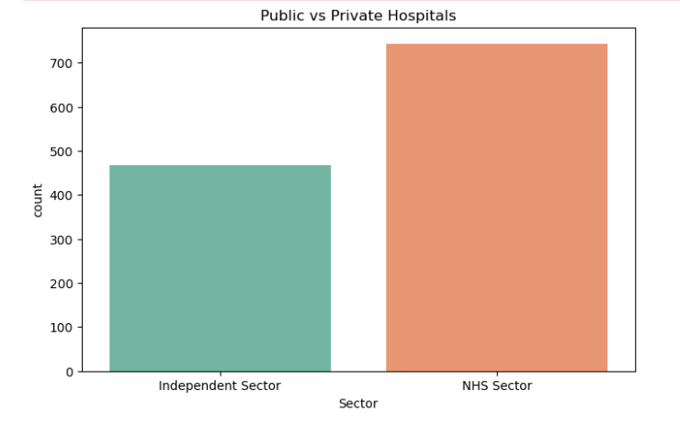
Public vs Private Hospitals

Slide 17
Advanced Data Analysis
Number of Hospitals by Region (City, County)
Percentage of Hospitals Managed by NHS vs Independent Sector

Slide 18
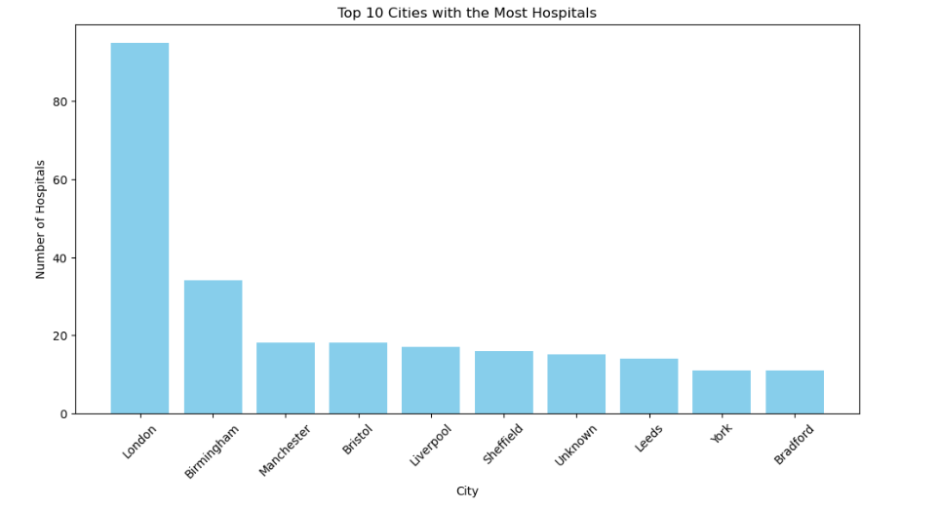
Number of Hospitals by City
The bar plot clearly shows that London has a significantly higher number of hospitals compared to other cities.
This concentration of hospitals in London likely reflects its larger population and status as a major metropolitan area. Other major cities like Birmingham, Manchester, and Bristol also have a notable number of hospitals.

Slide 19
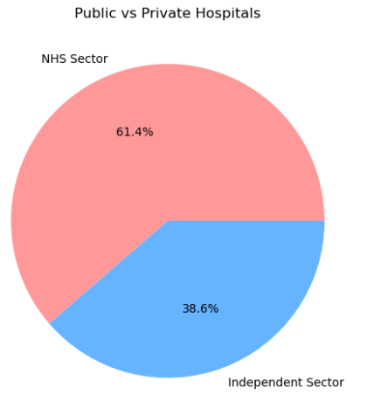
Percentage of Hospitals Managed by NHS vs Independent Sector
The pie chart clearly illustrates that the NHS Sector represents a larger proportion (61.4%) of hospitals compared to the Independent Sector (38.6%). This visual representation emphasizes the dominance of public healthcare provision in the dataset

Slide 20
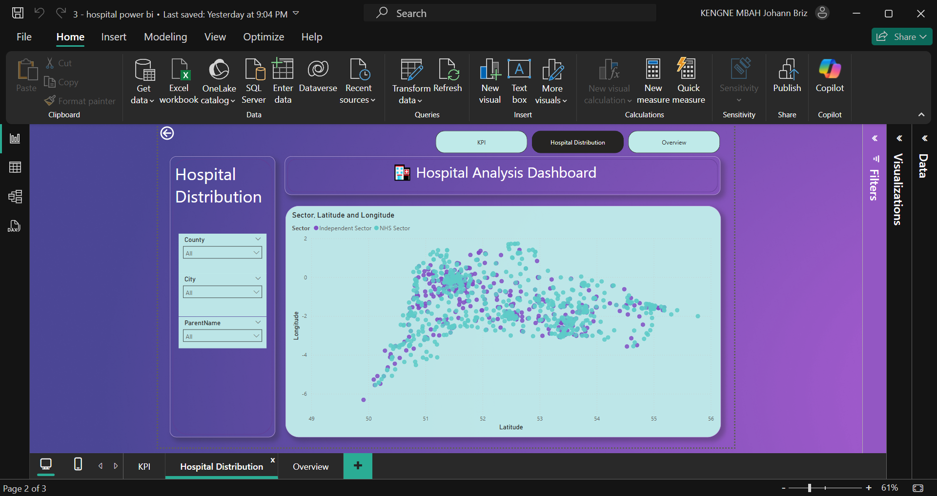
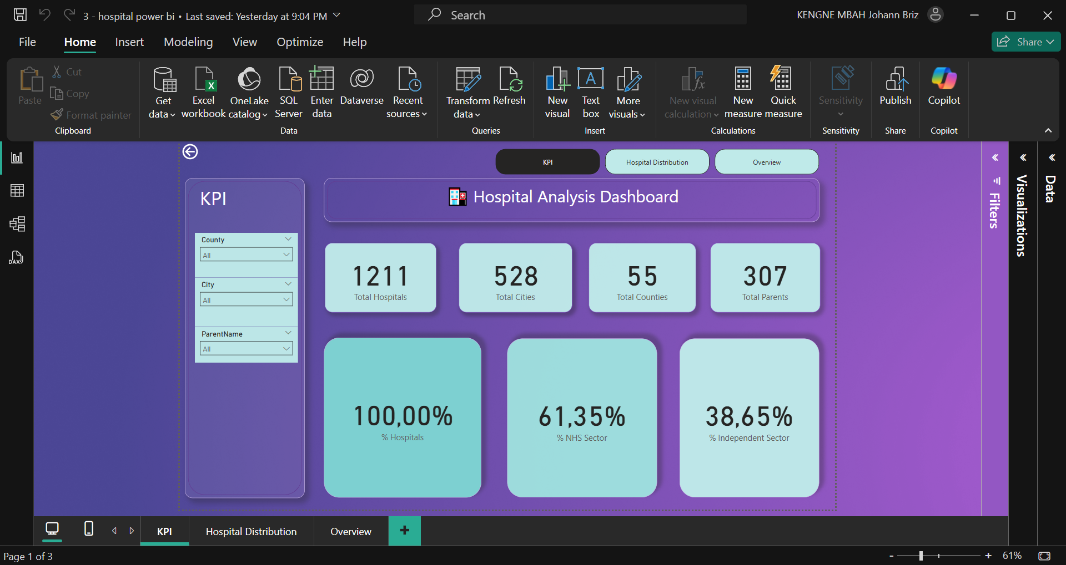
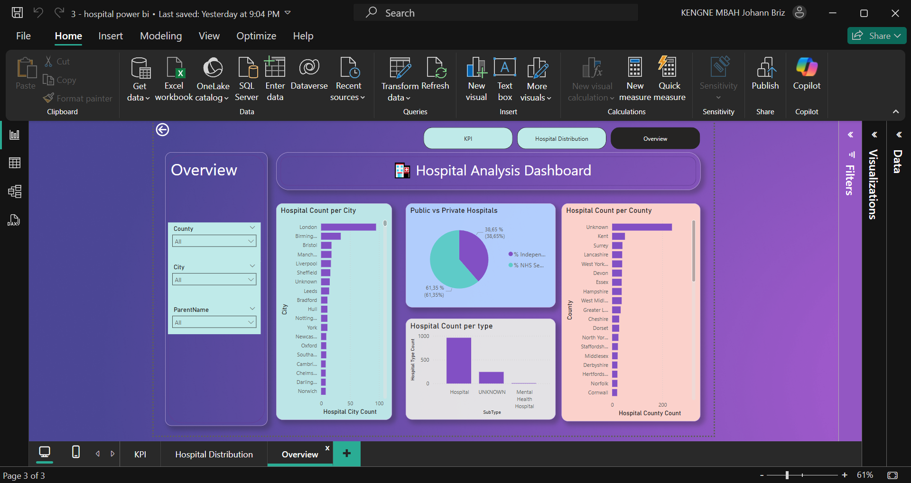
Dashboard
This KPI screen provides a clear, immediate statistical snapshot of the hospital landscape covered by the data, highlighting the total number of facilities, their geographical distribution across cities and counties, their organisational groupings, and a crucial breakdown between NHS and independent providers. The filtering options offer the capability for more granular analysis
The Overview screen provides a useful dashboard summary by combining different perspectives: geographical distribution (by city and country), sector balance (NHS vs Independent), and facility type. It allows for a quick understanding of the key characteristics and distributions within the hospital dataset.
The Hospital Distribution view offers a visual representation of where NHS and Independent sector hospitals are located based on their latitude and longitude. It helps in understanding the geographical density and spread of healthcare facilities across the regions covered in the dataset.

Slide 21
Strategic Recommendations
Parent Organizations
The analysis of parent organisations reveals that a few large entities control a significant number of hospitals. It is important to monitor the influence of these organisations to ensure fair competition, prevent monopolies, and protect patient interests.
Service Planning
The data shows that "Hospital" is the most common type, indicating a prevalence of general hospitals. However, "Mental Health Hospital" also appears as a significant subtype. Therefore, service planning should prioritize general healthcare needs while also ensuring adequate resources and facilities for mental health services.
Sector Balance
The analysis of hospital sector shows that both the NHS and Independent sectors contribute substantially to healthcare provision. Healthcare policies and funding models should consider the roles and interactions of both sectors to optimize overall healthcare delivery.
Geographic Disparities
The heatmap visualisation clearly indicates that hospitals are not evenly distributed across the region. Some areas have a high concentration, while others are sparsely served. To ensure equitable access to healthcare, resources should be directed towards developing facilities or enhancing services in the underserved regions.
Data Completeness
The analysis revealed that only a small percentage of hospitals have complete email contact information. This limits the potential for efficient digital communication with patients, other providers, and administrative bodies. Efforts should be made to improve the collection and maintenance of email data.

Slide 22
Conclusion
This presentation has shown key trends in hospital data, including geographic concentrations, sector distribution, and organizational influences. These findings are crucial for informed healthcare planning and resource allocation.

Slide 23


